Slide 1
System software and compiler design

Slide 2
System software and its types
What they are
They are software prepared by computer manufacturers

Slide 3
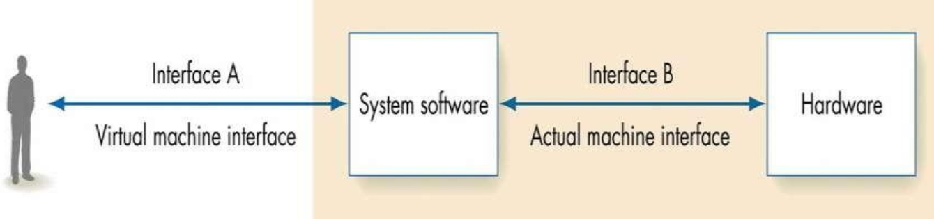
What they do
they operate, control and extend the processing capability of the computer itself.
they perform functions like file io, res mgt, io mgt, storage mgt etc.

Slide 4
SS
System control programs
Os and stuff, to control pc
System support programs
utility like dist management, device management, task manager
System dev
programs
interpreters, assemblers, compilers etc.

Slide 5
System dev programs
To develop more software
So naturally this includes
Assembler (asm)
Interpreter (python)
Compiler (C)

Slide 6
Assembler
Convert to assembly language depending on what environment you are running things on.
Let us elaborate that.

Slide 7
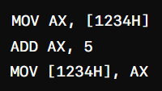
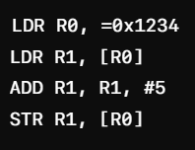
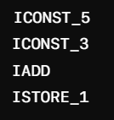
Instruction sets
1. CISC – complex instruction set arch
2. RISC – reduced instruction set arch
3. Stack based - JAVA

Slide 8
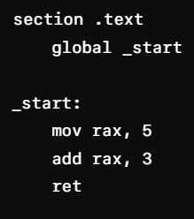
So assembler converts ur code into the underlying architecture machine code
48 C7 C0 05 00 00 00 48 83 C0 03 C3

Slide 9
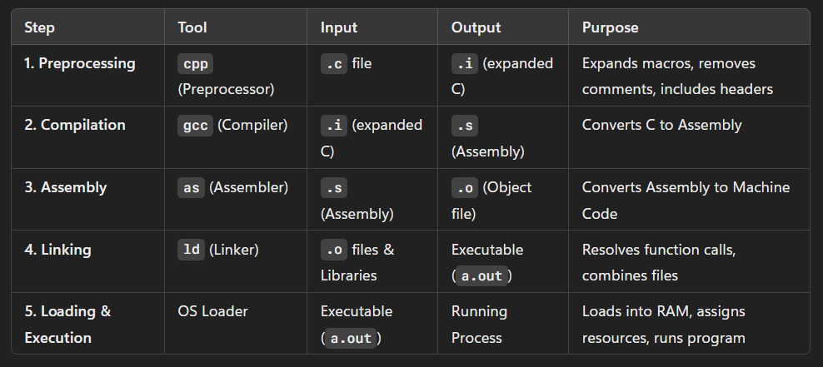
Working of a C program

Slide 10
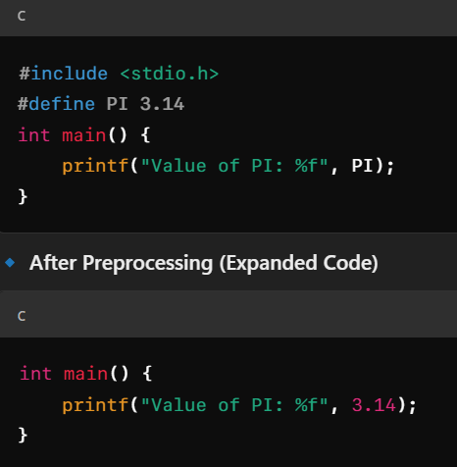
1 Pre processor

Slide 11
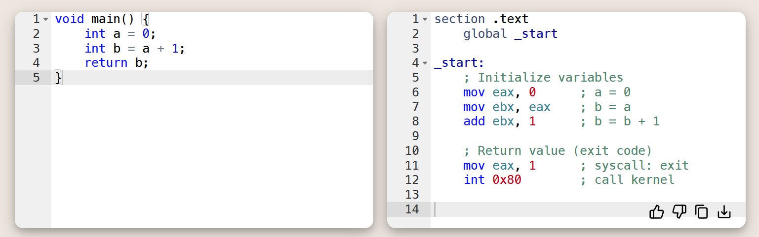
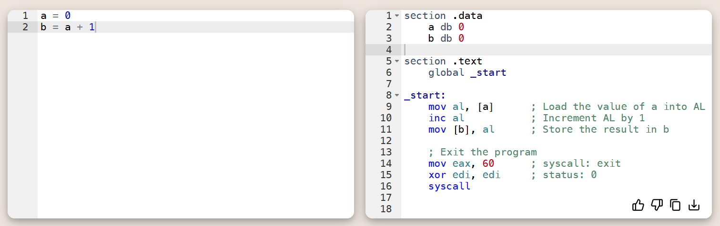
2. Compiler

Slide 12
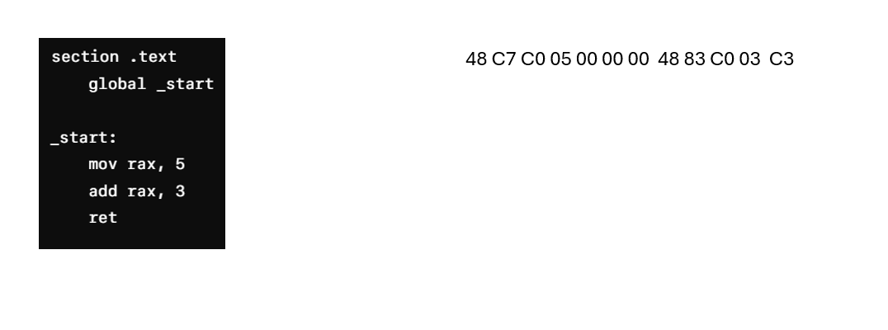
3. assembler

Slide 13
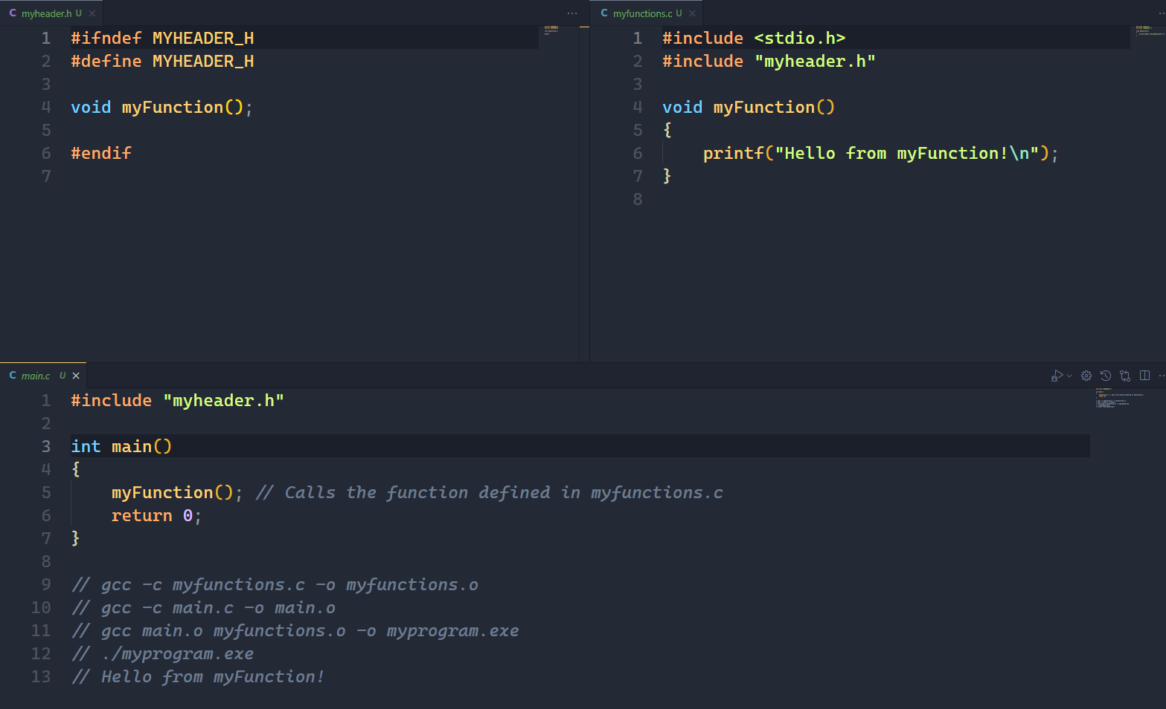
4. Linker

Slide 14
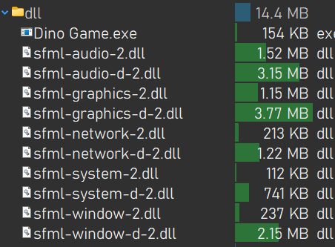
5. Loader

Slide 15
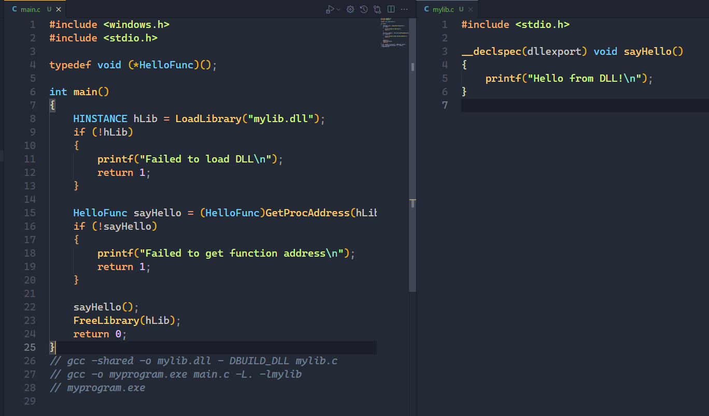

Slide 16
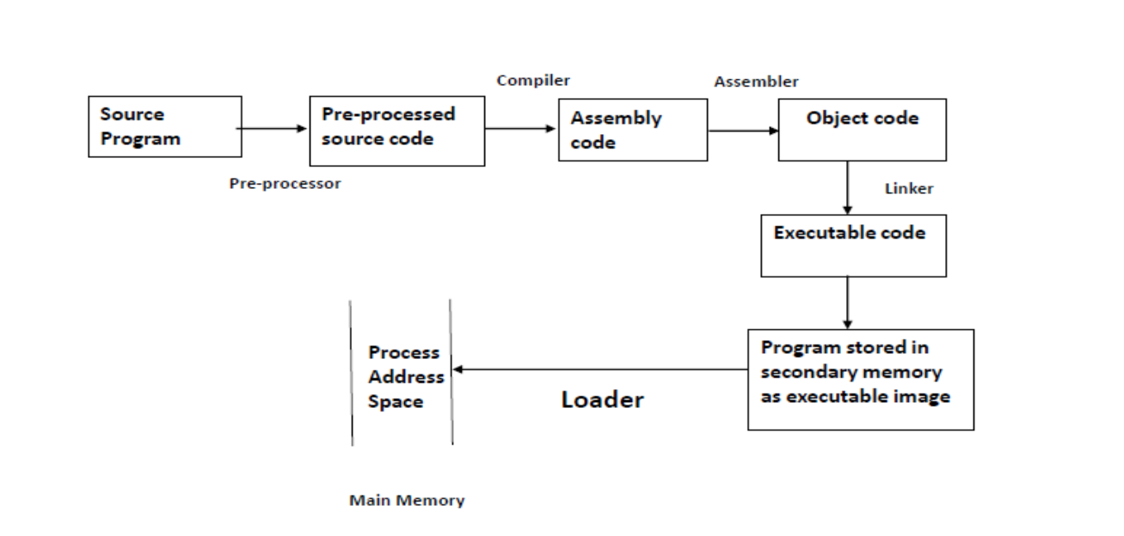

Slide 17
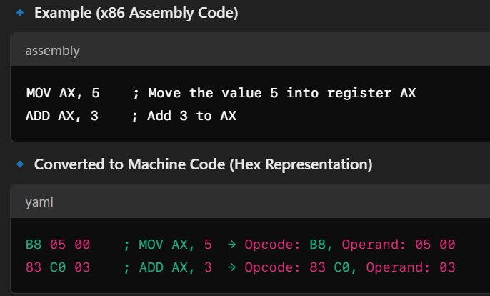
Assembler functions
1. Convert Symbolic Opcodes to Binary

Slide 18
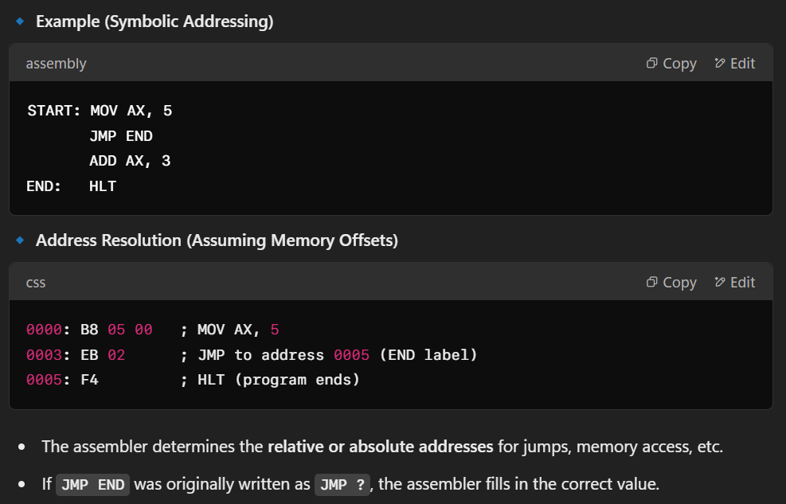
Convert Symbolic Addresses to Binary

Slide 19
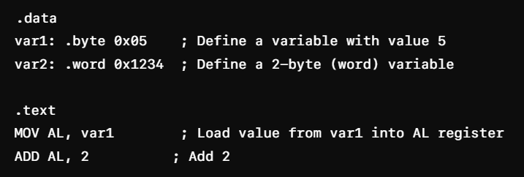
Perform Assembler Services Requested by Pseudo-Ops

Slide 20
Put Translated Instructions into a File for Future Use
as -o program.o program.s
ld -o program program.o

Slide 21
